Slide 1
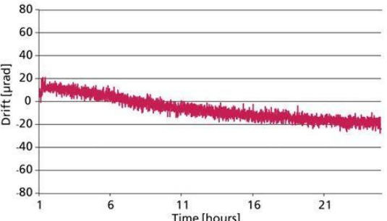
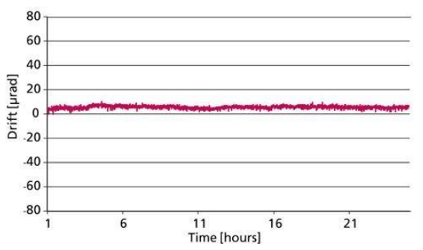
Position Detector
<<Galvanometer Scanners with Digital Position Sensors Meet Industry's Toughest Challenges>>, 2015.2.5, Dr. Michael Breit & Dr. Hans-Joachim Muenzer, ScanLab
Analog Position Detector
Usually use an optical detection method
Cost effective for many of industry’s laser applications
A motor-shaft-bonded element between an LED light source and a photo-detector casts a shadow onto the detector, with intensity fluctuating depending on the shaft’s rotation angle.
Assorted thermal properties of the employed components produce unwelcome drift effects that can only be partially mitigated.
Such disadvantages are now overcome by switching to digital position detectors.
Enhanced Stability
Long-term Stability Differences of Galvo Scanners With Various Position Detectors, Based on Optical Measurement Data
Analog Position Detector Digital Position Detector

Slide 2
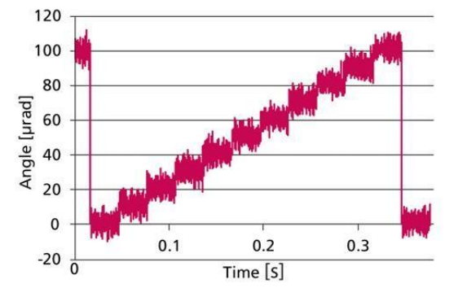
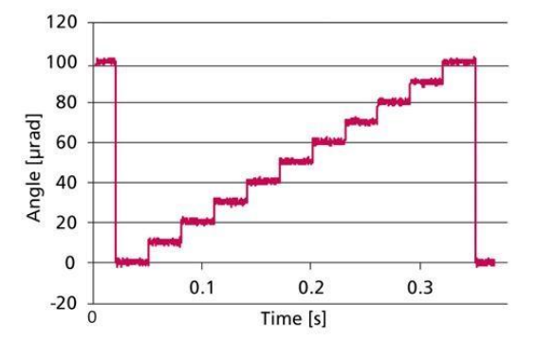
Position Detector
<<Galvanometer Scanners with Digital Position Sensors Meet Industry's Toughest Challenges>>, 2015.2.5, Dr. Michael Breit & Dr. Hans-Joachim Muenzer, ScanLab
More Precision
Step Scan With 10 Very Short Jumps in 10-urad Range
Analog Position Detector Digital Position Detector

Slide 3
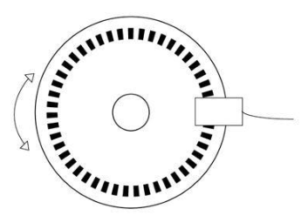
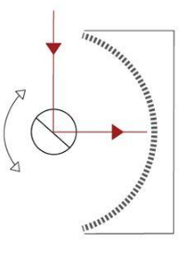
Position Detector
<<Galvanometer Scanners with Digital Position Sensors Meet Industry's Toughest Challenges>>, 2015.2.5, Dr. Michael Breit & Dr. Hans-Joachim Muenzer, ScanLab
Encoder Technology
To date, digital position detectors is using incremental encoders.
The key advantage of digital encoders over analog PD is digital PD is much less sensitive to disturbances, and can exhibit significantly lower noise/drift.
With its patented digital se-encoder, SCANLAB has succeeded in breaking dynamic-performance limitations while retaining highest precision.
Common digital encoder (disc) ScanLab Patent “light-pointing encoder”

